Slide 1


Generating Images Using a Deep Convolutional GAN
Supervisor: Dr. Serhiy Yanchuk
Speaker: Kai Deng
27/09/2024

Slide 2

01
Introduction
02
Historical Models
Overview
03
Theoretical Background
04
Results
05
Discussion

Slide 3
1 Introduction

Slide 4


Introduction
1
Generative Adversarial Network (GAN)
Challenges
Objectives
What

Slide 5
2 Historical
Models

Slide 6
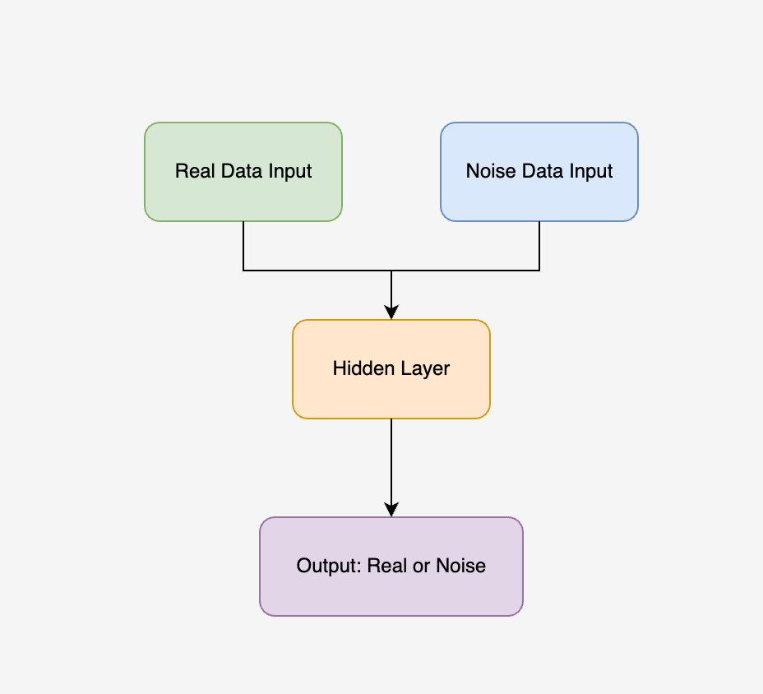
2
Noise Contrastive Estimation
Architecture
What is the NCE?
NCE is a statistical method that simplifies learning by contrasting real data with noise[1].
Applications:
• Density estimation and language modelling[2].
• Laying the groundwork for image generation.

Slide 7
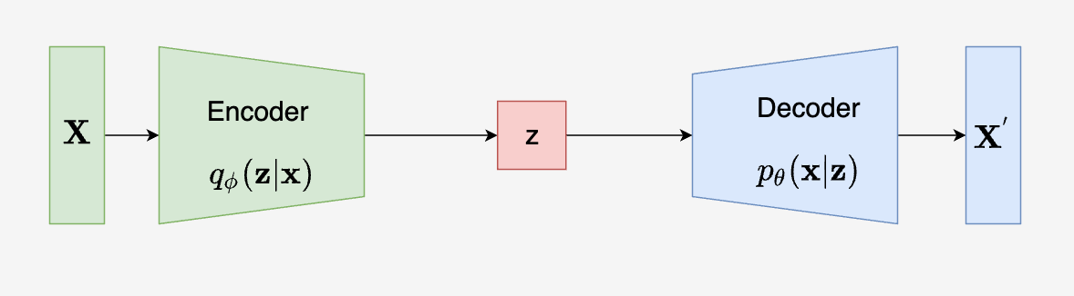
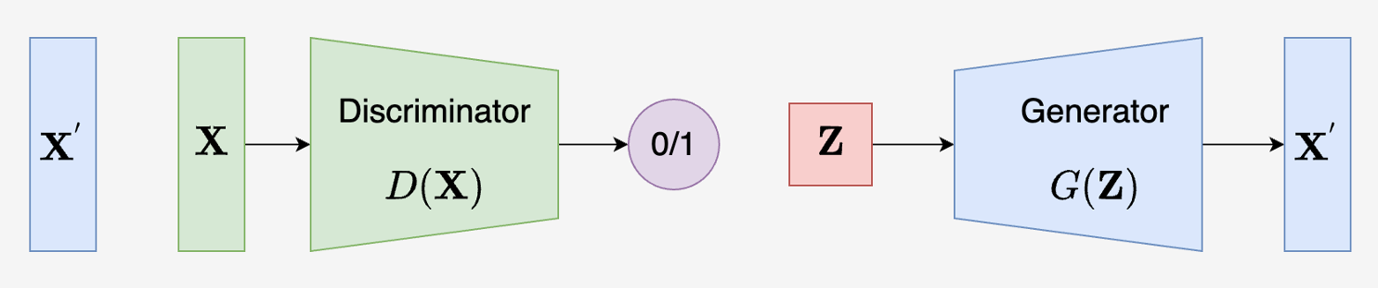
3
Variational Autoencoder
What is the VAE?
VAE is a generative model that encodes input data into a latent space and reconstructs it by minimizing the reconstruction loss[3].
Architecture:
Applications:
Image generation, data compression.
Notes:
The Goodfellow only adds a small circle in the middle; then, the new model can generate amazing realistic images.
The left side is ..., and the right side is ...

Slide 8
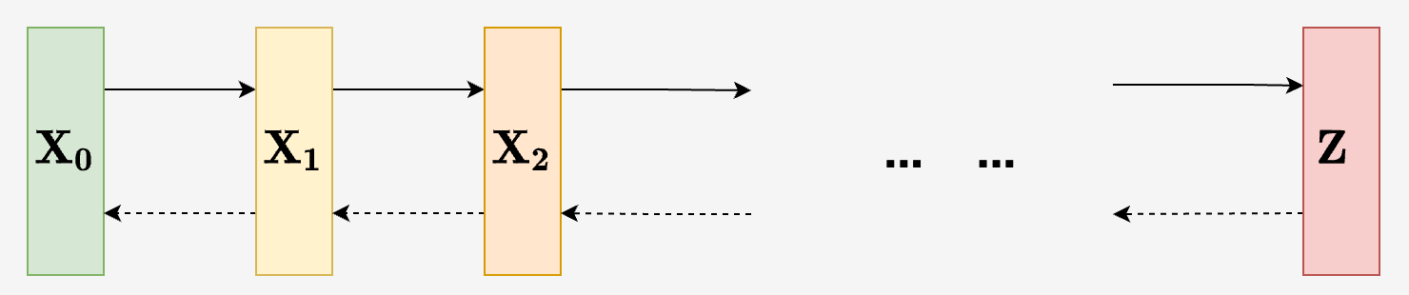
Diffusion Model
4
What is the Diffusion Model?
Progressively add noise to the data and learn to reverse this process to generate high-quality outputs[4].
Architecture:
Applications:
Text-to-image generation.

Slide 9
3 Theoretical Background

Slide 10
5
Objective Function of GAN
Objective Function:
It is like a minimax game between the generator and the discriminator[5].
Formula:
Generator’s Goal:
Minimize the probability that the discriminator correctly identifies fake data.
Discriminator’s Goal:
Maximize the probability of correctly distinguishing real from fake data.

Slide 11
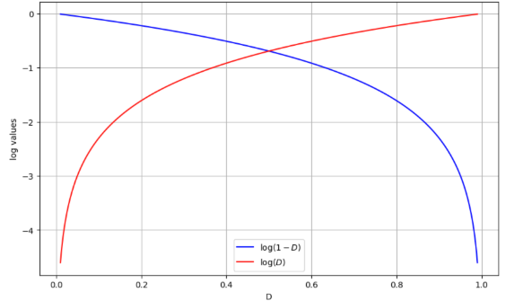
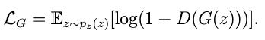
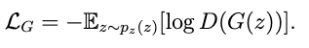
6
Loss Function of GAN
Discriminator’s Loss:
Measures how well the discriminator classifies real and fake data[6].
Loss function:
Generator’s Loss:
Measures how well generator fools discriminator[6].
Loss function:
x
Figure : Diagram for log(1-D) and log D

Slide 12
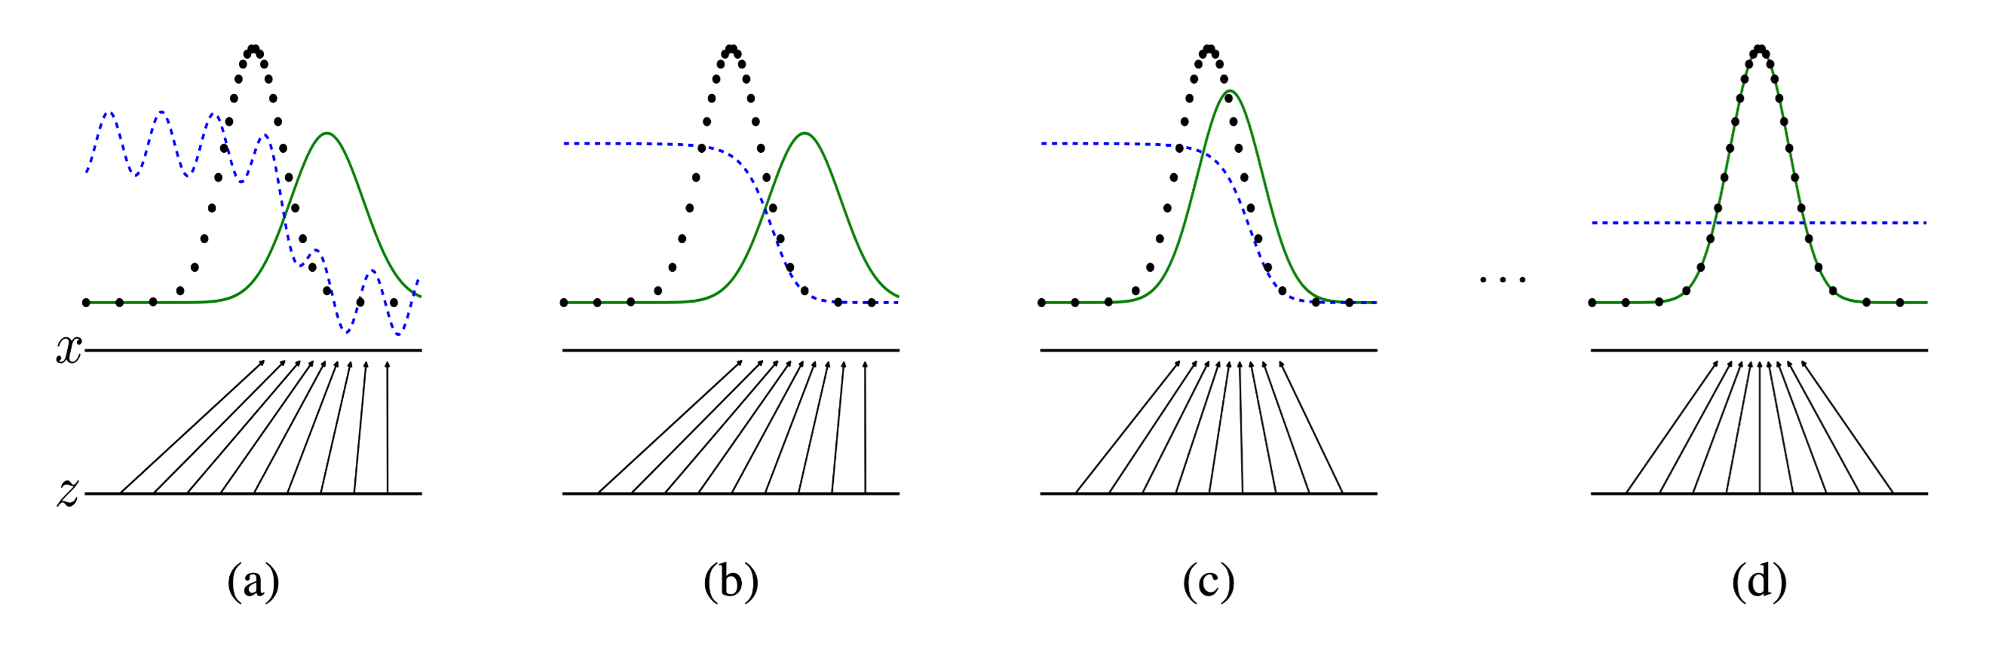
7
Training Process of GAN
Figure: Distribution Change during GAN Training
Source: I. J. Goodfellow, "Generative adversarial nets," 2014.
Green curve: generated data distribution. Black dots: real data distribution (constant). Blue line: the output of the discriminator.

Slide 13
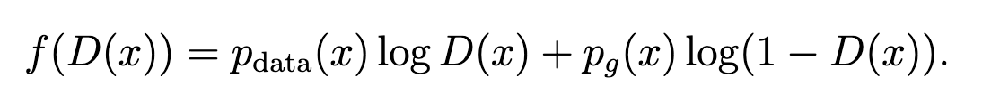
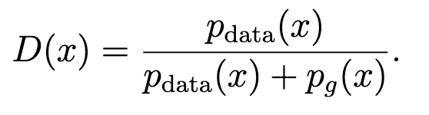
8
Optimal Discriminator
The objective function to maximize :
Rewriting the Objective Function:
Converting to an antiderivative :
Deriving and setting the derivative to zero:
Notes:
when p_data(x) = p_g(x), the output of the discriminator is 50%. This is why when the green line stacks on the black line, the blue moves to the middle.

Slide 14
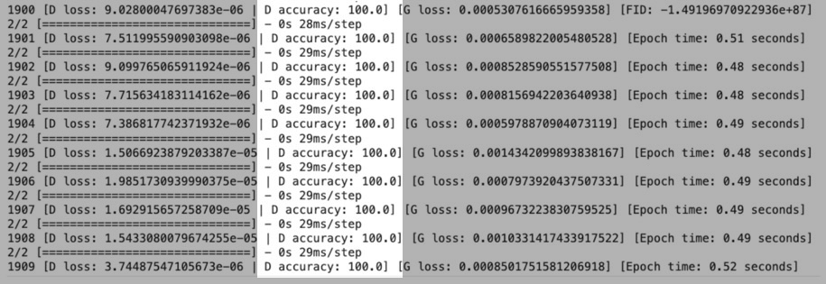
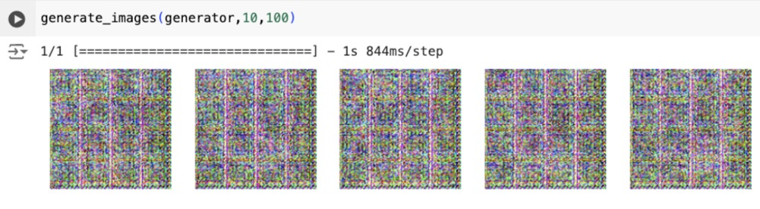
9
Evaluating GAN Performance
A GAN model with high accuracy means the balance between the generator and the discriminator is broken.
x

Slide 15
4 Results

Slide 16
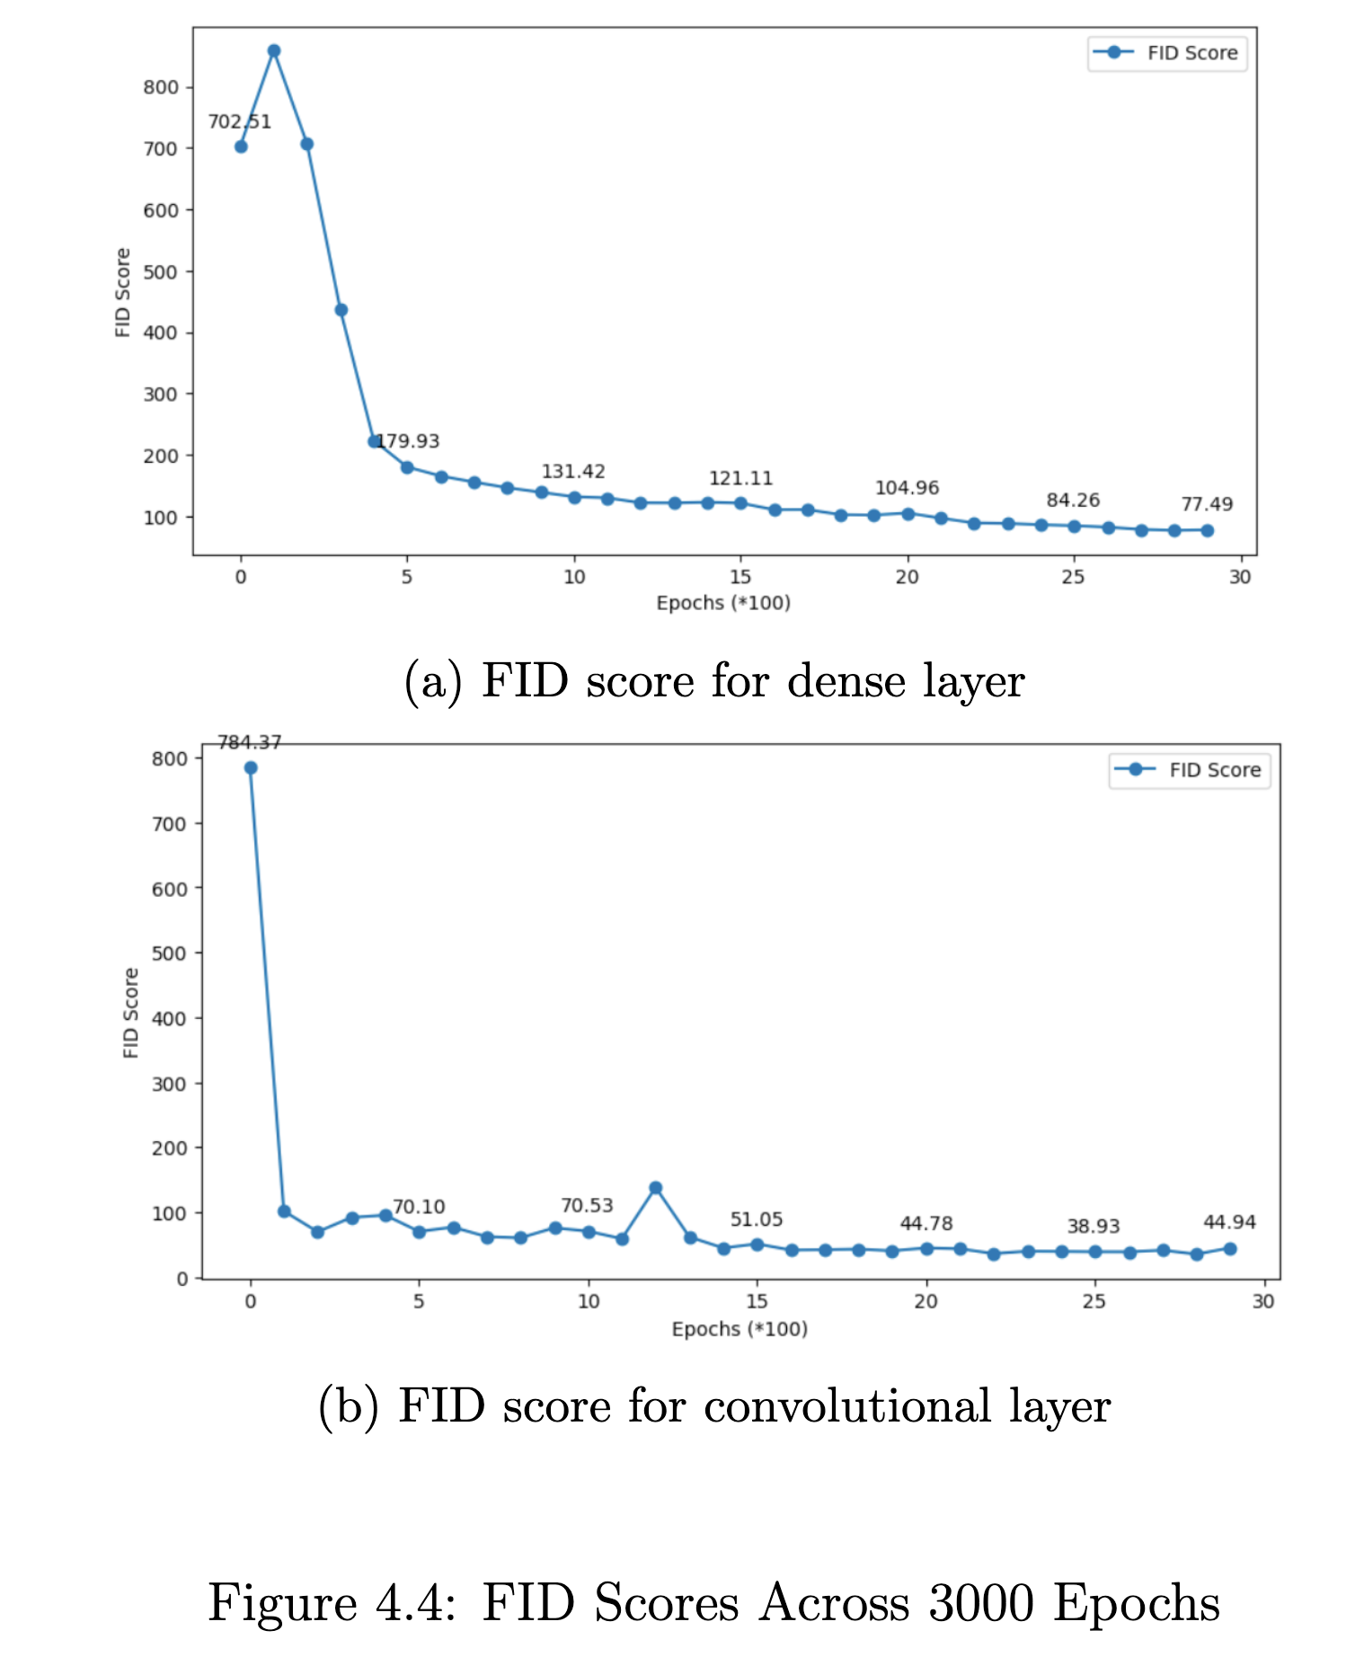
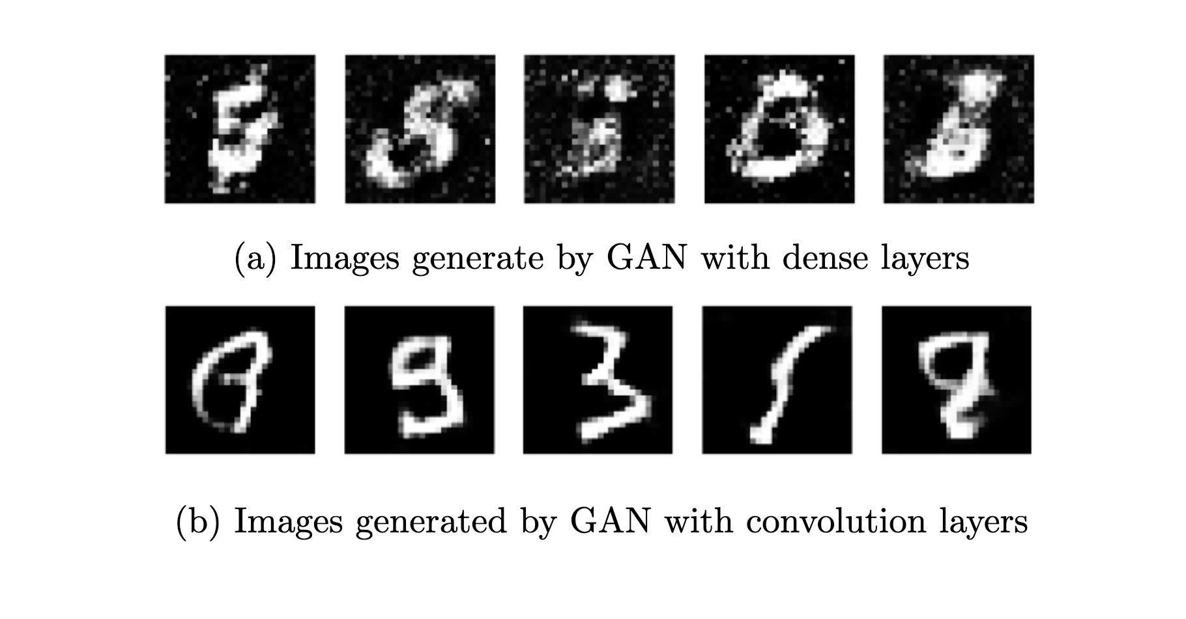
10
Convolutional or Dense
Objective:
Compare the GAN model with Convolutional Layers and Dense Layers.
Dataset:
MNIST.
Key Factors Tested:
• Image quality.
• FID score.
x

Slide 17
11
Exploring Layer Depth
Objective:
• Impact of increasing layer depth.
Experiment Setup:
• Base Model: 3 layers standard GAN.
• Layer Variations: 4, 5, and 6 layers in both generator and discriminator.
• Key Metric: FID score.
Dataset:
MNIST.

Slide 18
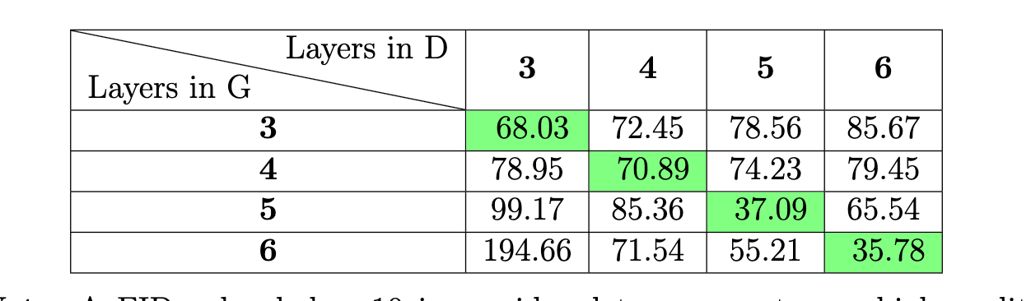
12
Exploring Layer Depth
Table: Average FID Score for Different Layer Depth.
FID score: 0 - 10: perfect, 0 – 50: good, > 50: poor.
Result: The balance between generator and discriminator is crucial.[7]

Slide 19
13
Impact of Data Augmentation
Objective:
• Impact of data augmentation.
Dataset:
MNIST.
Techniques Tested:
• Rotation: Rotating images by a 10 degree.
• Shifting: Vertical and horizontal shift 0.1.
• Flipping: horizontal flips.
After Adjustments:
• Removing certain techniques (e.g., flipping, rotation).

Slide 20
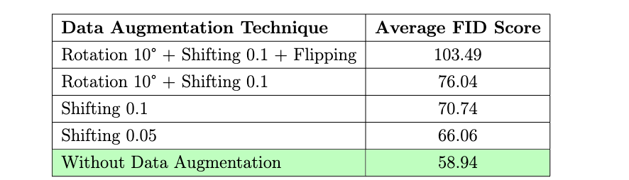
14
Impact of Data Augmentation
Results
Assumption:
Data augmentation may introduce noise, disturbing the real data distribution[7].
Table: Average FID Score for Different Augmentation Techniques.
FID score: 0 - 10: perfect, 0 – 50: good, > 50: poor.

Slide 21
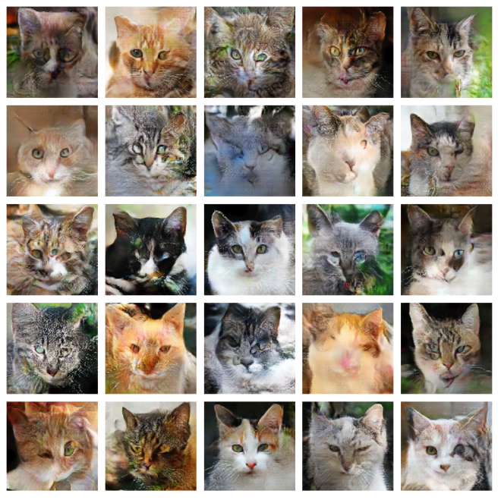
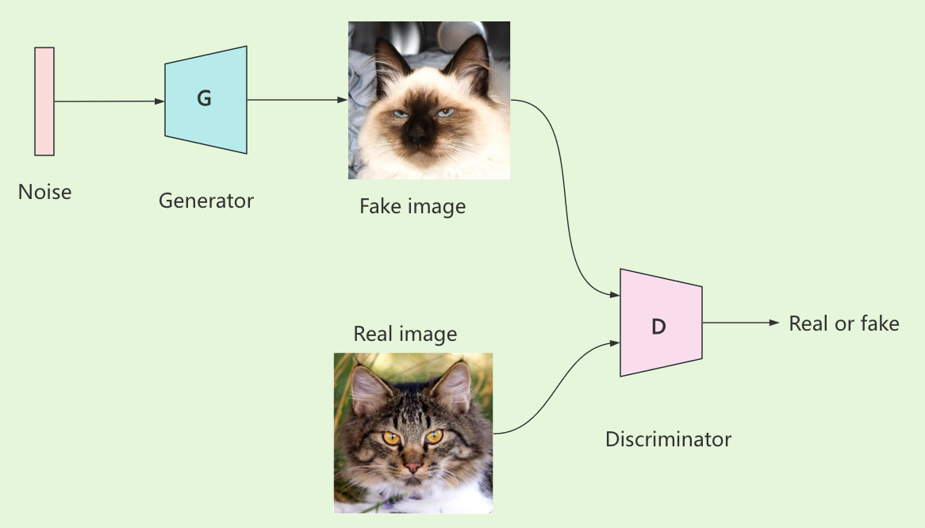
Applying Animal Faces HQ Dataset
15
Dataset Overview:
• 16,130 high-quality images of animal faces.
• 512x512 pixels.
Model Structure:
• Generator: 5 transpose convolutional layers. • Discriminator: 5 convolutional layers.
Training Details:
• Optimizer: Adam.
• Learning rate: 0.002.
• Epochs: 4000.

Slide 22
5 Discussion

Slide 23

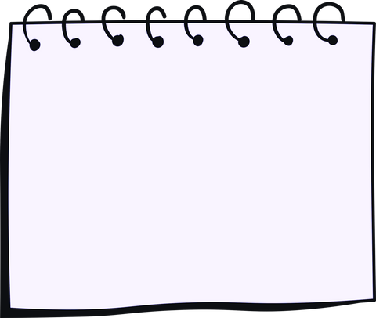
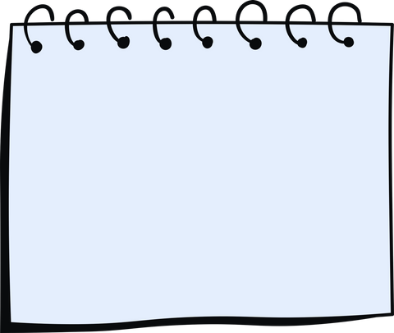
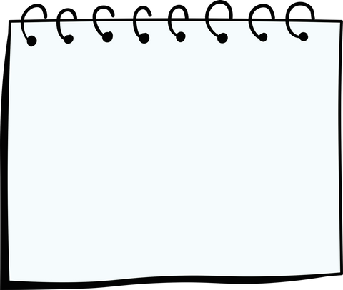
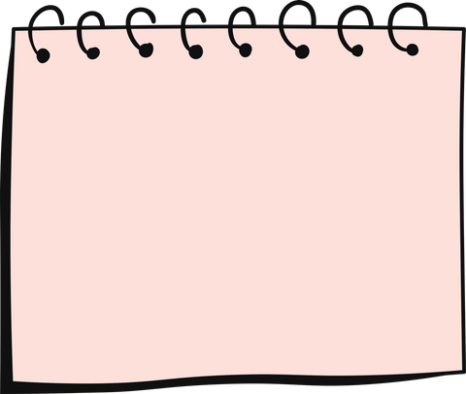
Summary and Future Work
16
1
2
3
4
GAN with dense layers or convolutional layers.
Exploring layer depth.
Impact of data augmentation
Applying the GAN model with the Animal Faces-HQ dataset.

Slide 24


University College Cork
Thank You

Slide 25
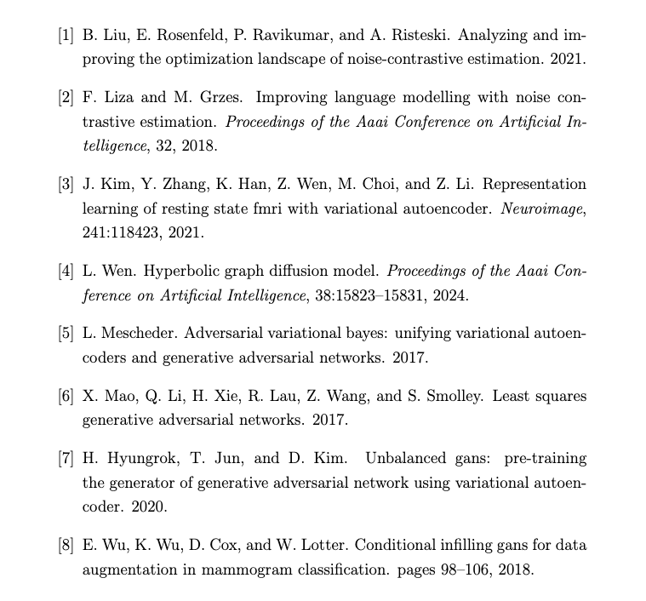
References
17

Slide 26
6 Appendix

Slide 27
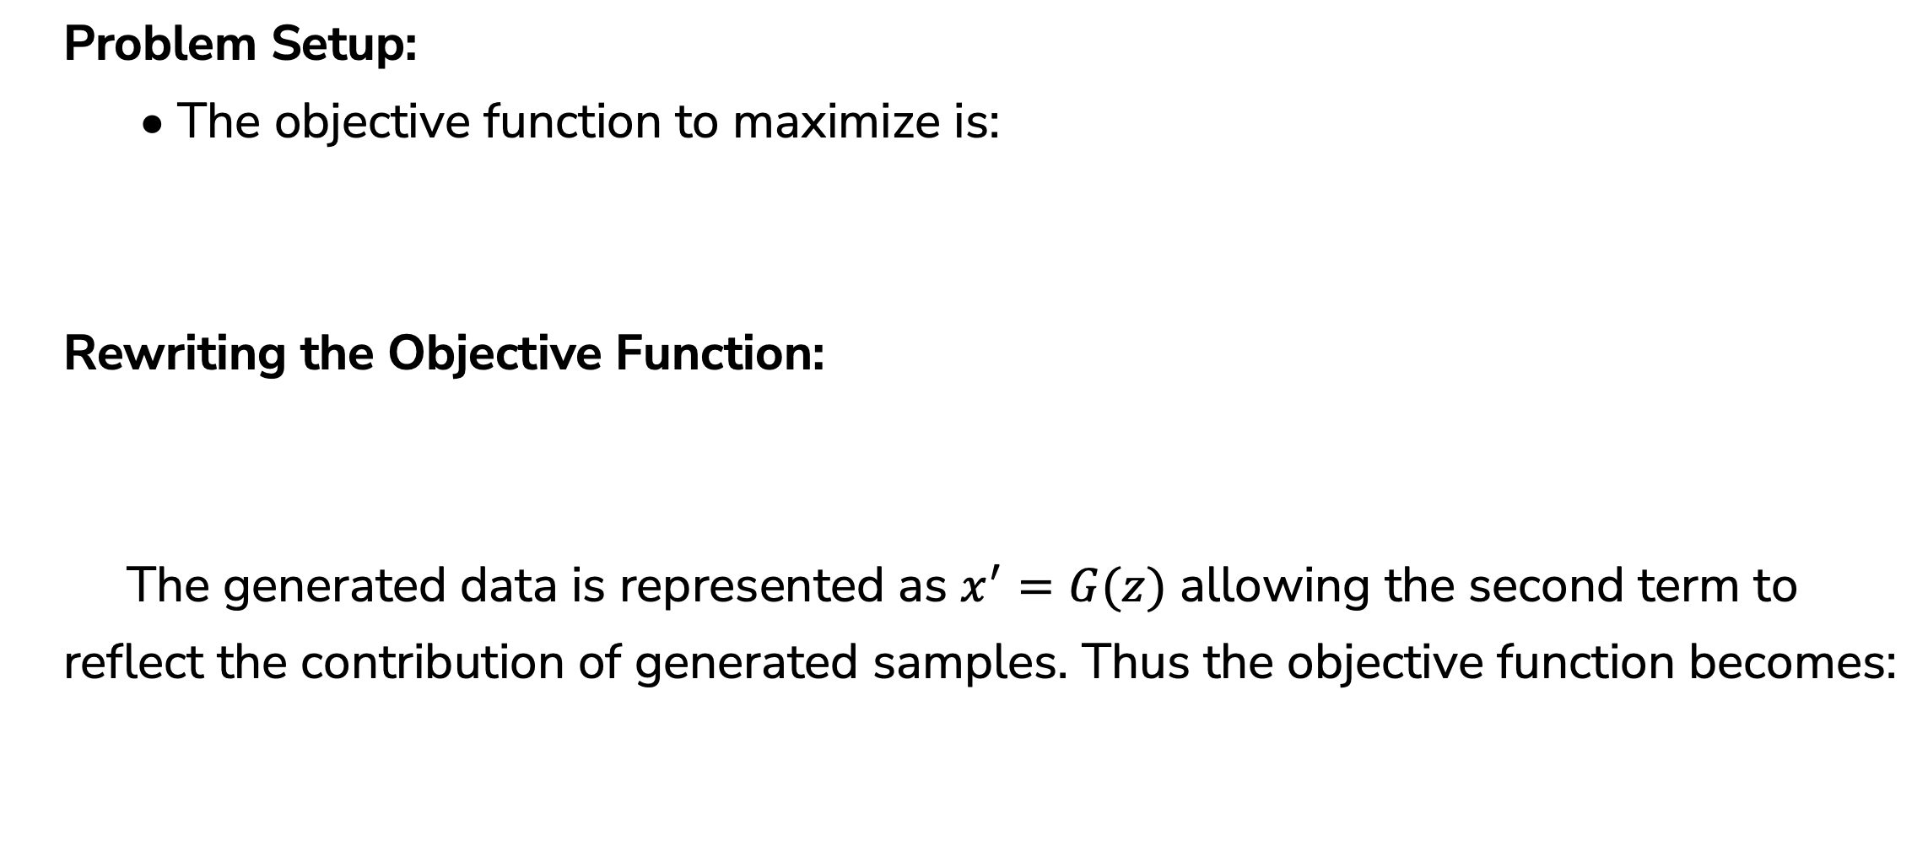
1
Training Process of GAN
Problem Setup:
• The objective function to maximize is:
Rewriting the Objective Function:
The generated data is represented as $x^{′}=G(z)$ allowing the second term to reflect the contribution of generated samples. Thus the objective function becomes:

Slide 28
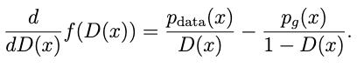
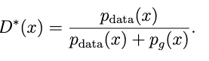
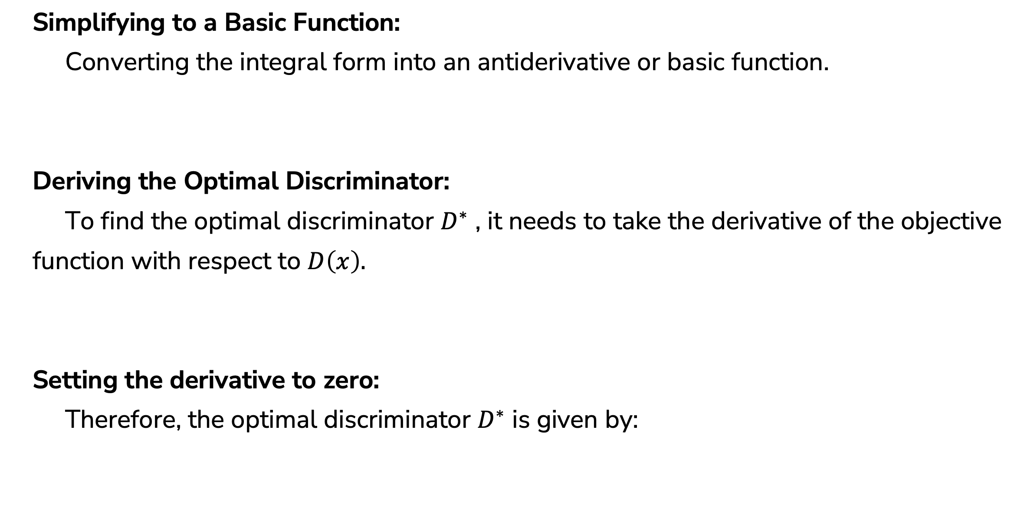
2
Training Process of GAN
Simplifying to a Basic Function:
Converting the integral form into an antiderivative or basic function.
Deriving the Optimal Discriminator:
To find the optimal discriminator $D^{∗}$ , it needs to take the derivative of the objective function with respect to $D\left(x\right).$
Setting the derivative to zero:
Therefore, the optimal discriminator $D^{∗}$ is given by:

Slide 29
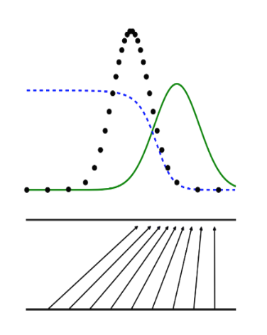
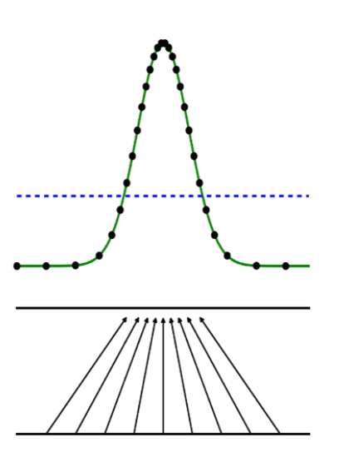
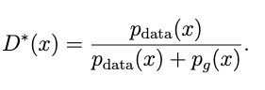
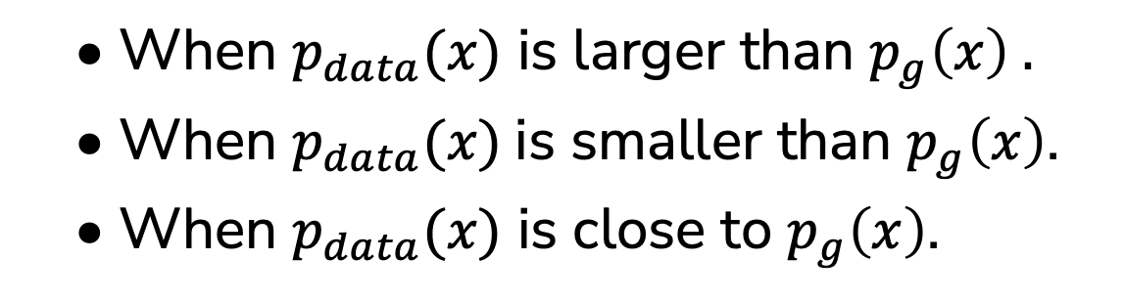
Verifying the Optimal Discriminator
3
• When $p_{data}(x)$ is larger than $p_{g}\left(x\right) .$
• When $p_{data}(x)$is smaller than $p_{g}\left(x\right)$.
• When $p_{data}(x)$ is close to $p_{g}\left(x\right)$.
x

Slide 30
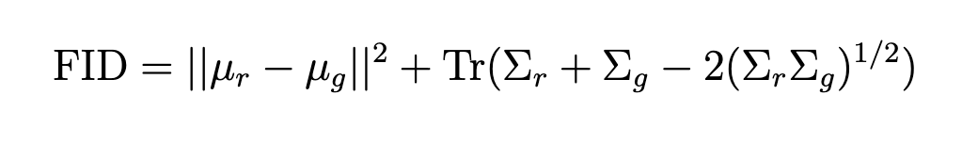
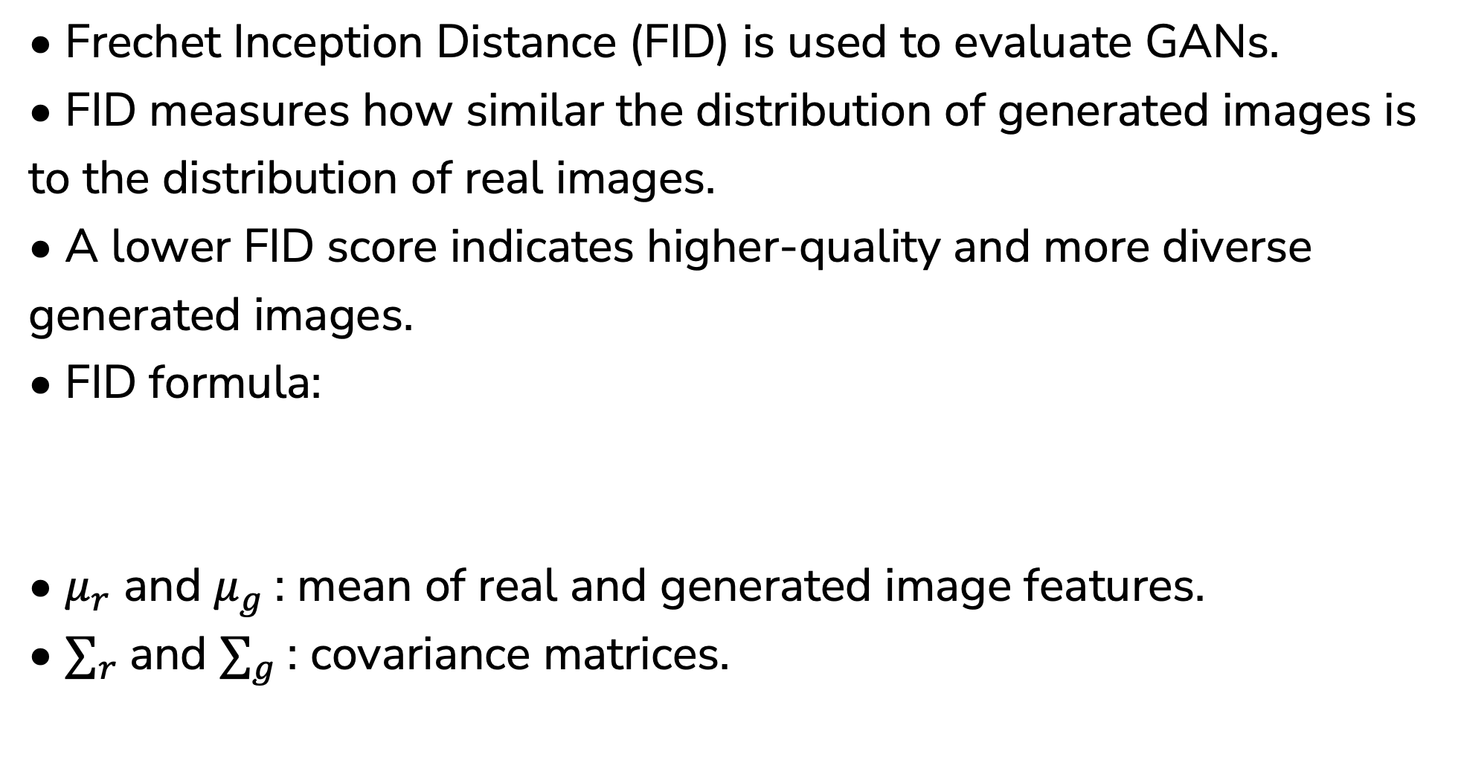
4
Frechet Inception Distance
• Frechet Inception Distance (FID) is used to evaluate GANs.
• FID measures how similar the distribution of generated images is to the distribution of real images.
• A lower FID score indicates higher-quality and more diverse generated images.
• FID formula:
• $μ_{r}$ and $μ_{g}$: mean of real and generated image features.
• $∑_{r}$and $∑_{g}$: covariance matrices.

Slide 31
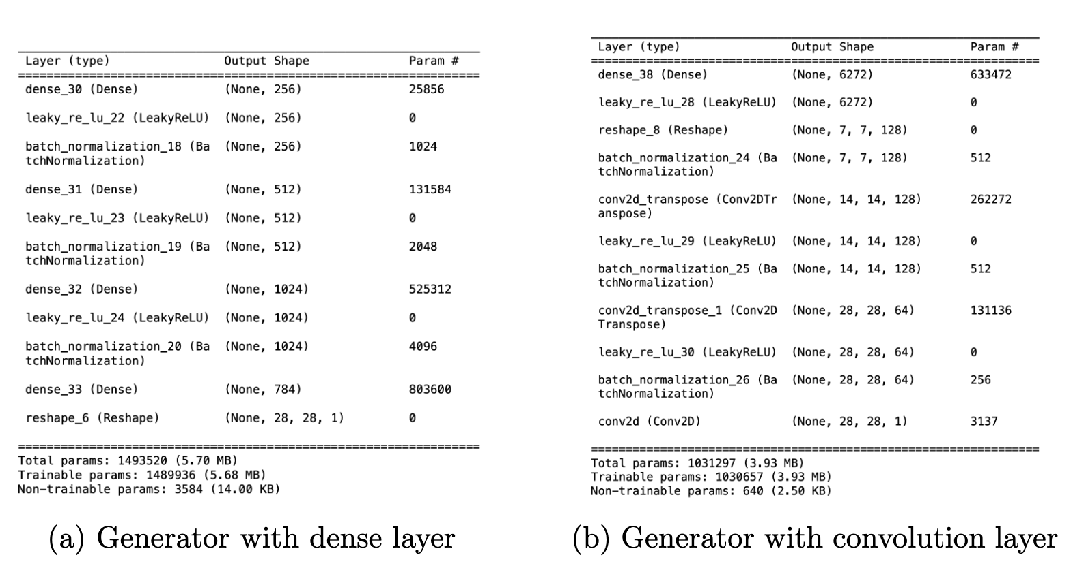
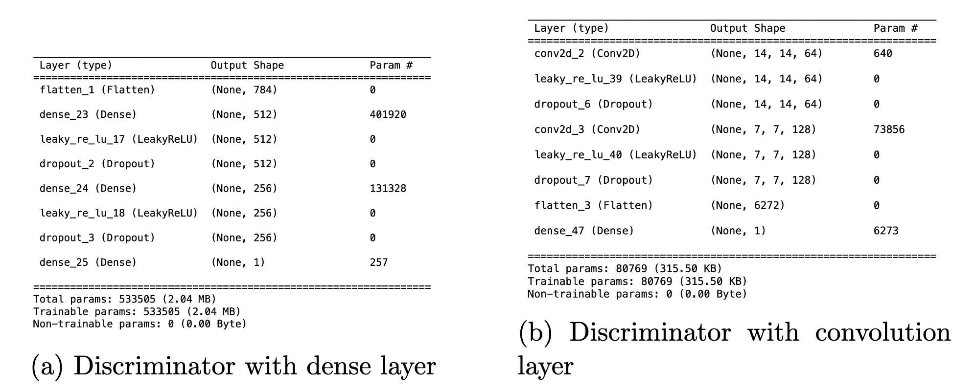
5
Convolutional or Dense
Objective:
Compare the GAN model with Convolutional Layers and Dense Layers.
Dataset:
MNIST.
Key Factors Tested:
• Image quality.
• FID score.
x

Slide 32
Generative Adversarial Network
6
What is GAN?
GAN consists two networks a generator and a discriminator that compete to improve data generation quality.
Architecture:
Applications:
Image generation, video synthesis, and style transfer.
x

Slide 33
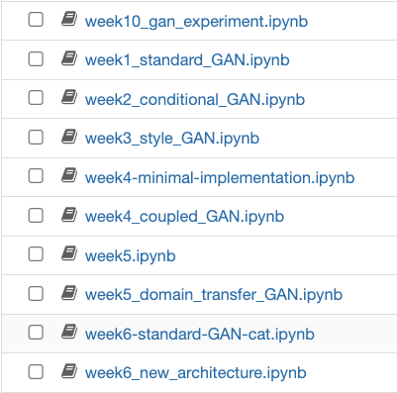
7
Model Select
Why Standard GAN:
• Foundational Model.
• Well documented.
• Training Efficiency.
• Flexibility in dataset.
x

